Slide 1
UNIT-V: APPLICATION LAYER
Domain Name System (DNS)-Name space,
Domain resource records, Name servers;
Electronic mail-Architecture and services,
User agent, Message formats, Message transfer,
Final delivery;
The World Wide Web- Architectural overview,
HTTP.

Slide 2
DNS – The Domain Name System
The DNS name space
Domain Resource records
Name servers

Slide 3
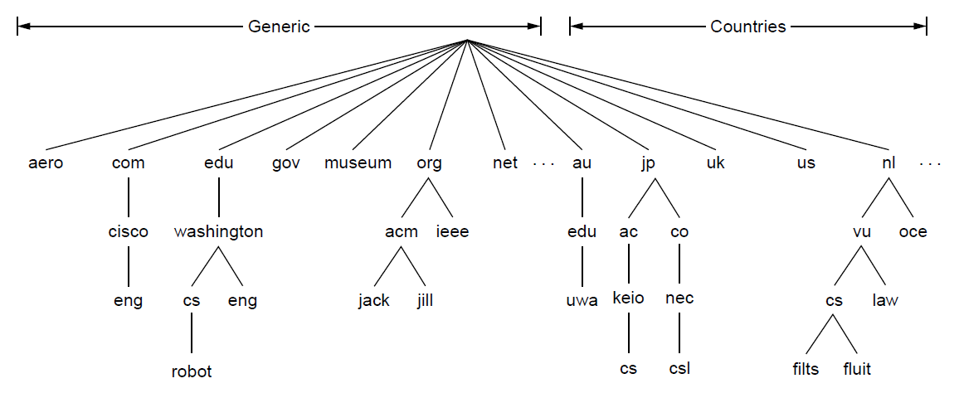
The DNS Name Space (1)
A portion of the Internet domain name space.

Slide 4
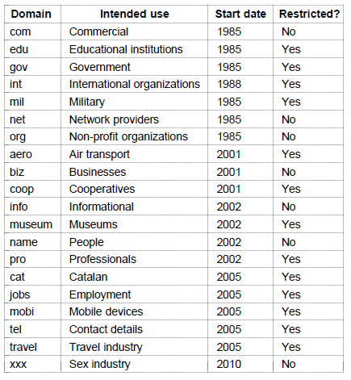
The DNS Name Space (2)
Generic top-level domains

Slide 5
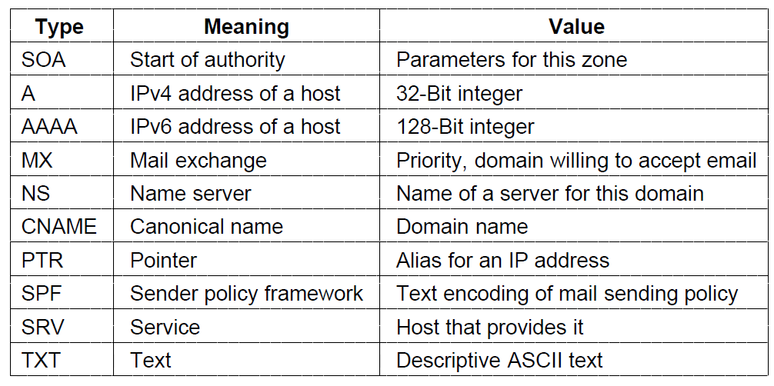
Domain Resource Records (1)
The principal DNS resource record types

Slide 6
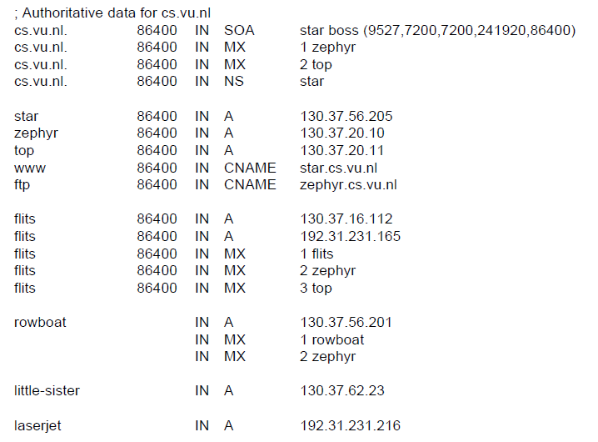
Domain Resource Records (2)
A portion of a possible DNS database for cs.vu.nl.

Slide 7
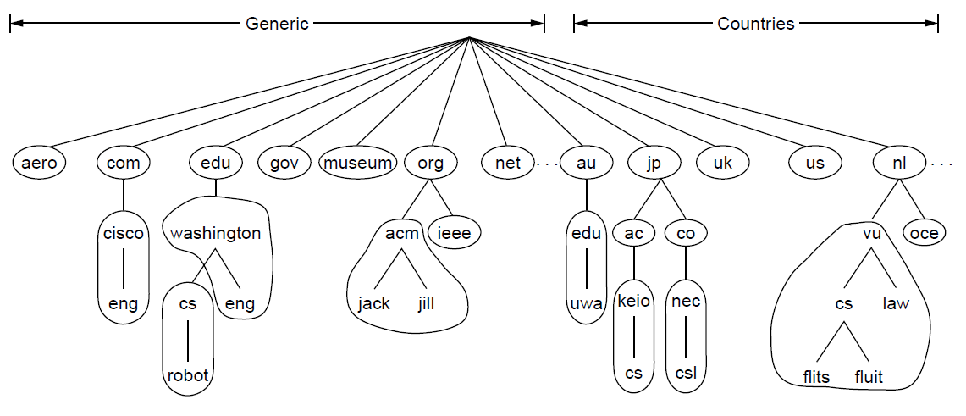
Name Servers (1)
Part of the DNS name space divided into zones (which are circled).

Slide 8
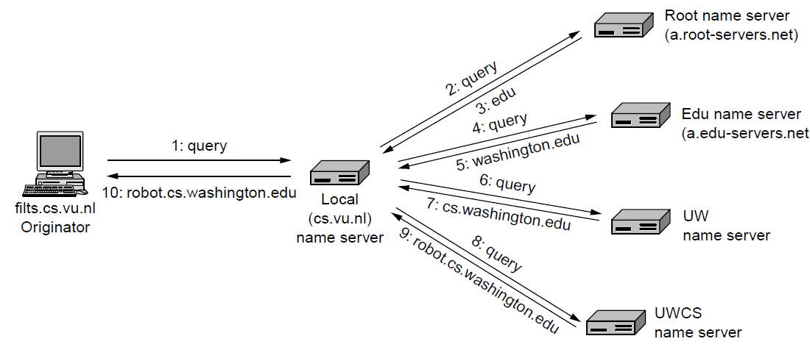
Name Servers (2)
Example of a resolver looking up a remote name in 10 steps.

Slide 9
Electronic Mail
Architecture and services
The user agent
Message formats
Message transfer
Final delivery

Slide 10
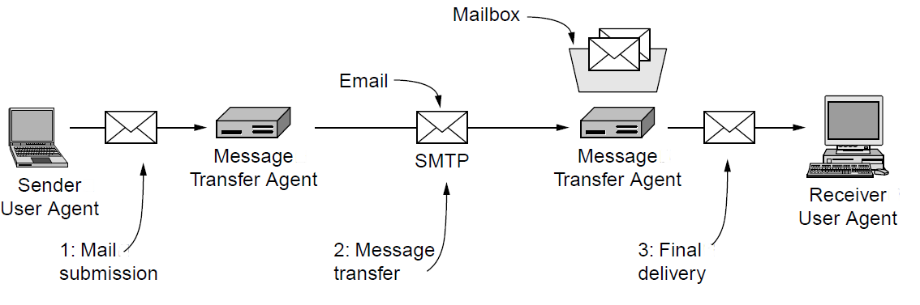
Architecture and Services (1)
Architecture of the email system

Slide 11
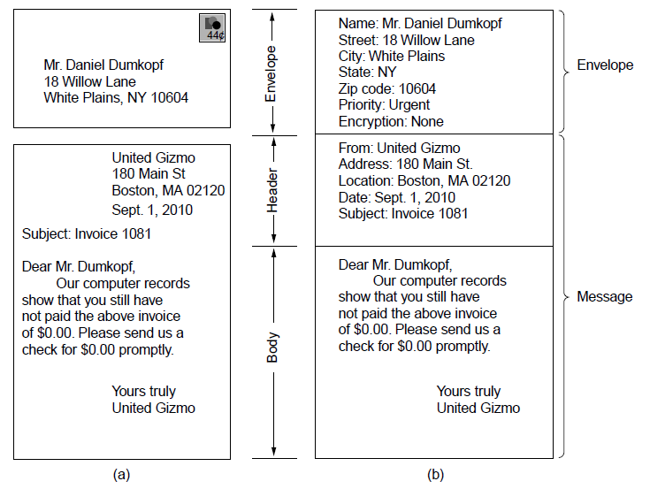
Architecture and Services (2)
Envelopes and messages. (a) Paper mail. (b) Electronic mail.

Slide 12
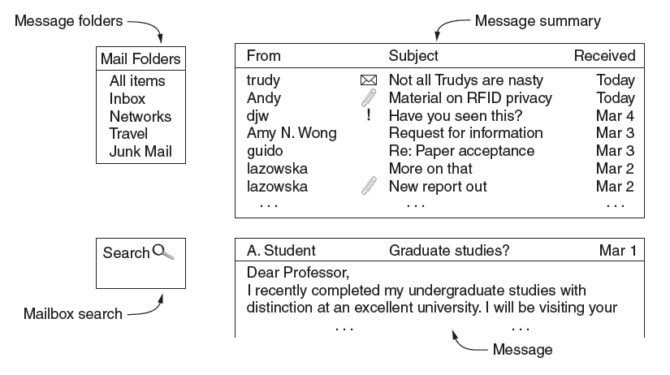
The User Agent
Typical elements of the user agent interface

Slide 13
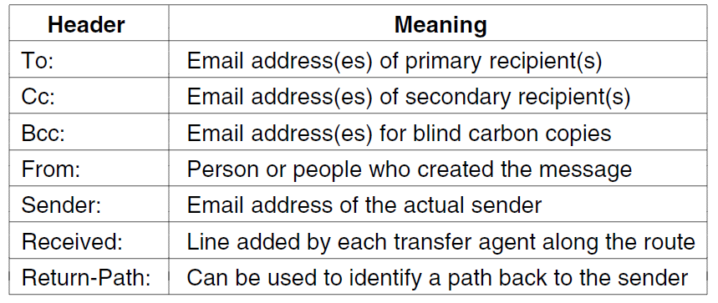
Message Formats (1)
RFC 5322 header fields related to message transport.

Slide 14
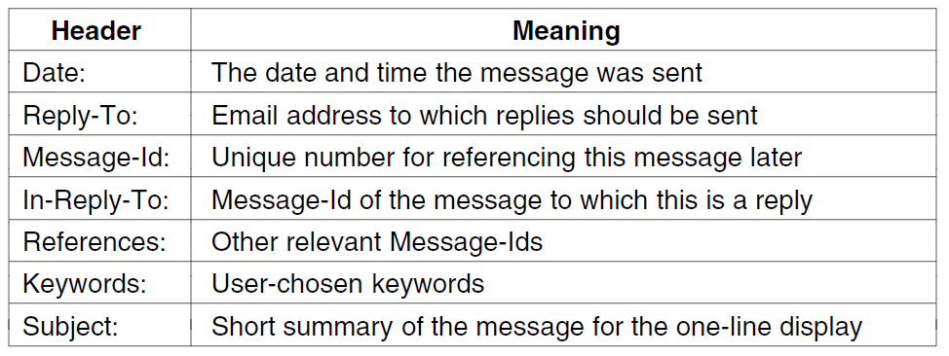
Message Formats (2)
Some fields used in the RFC 5322 message header.

Slide 15
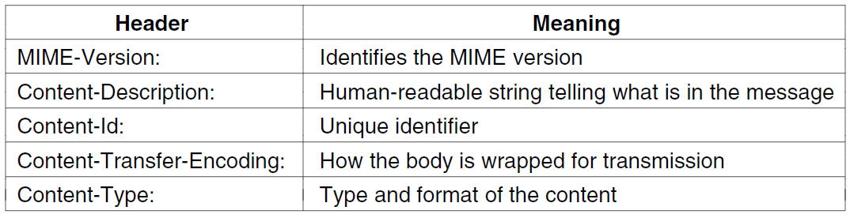
Message Formats (3)
Message headers added by MIME.
Multipurpose Internet Mail Extensions. It is used to extend the capabilities of Internet e-mail protocols such as SMTP.

Slide 16
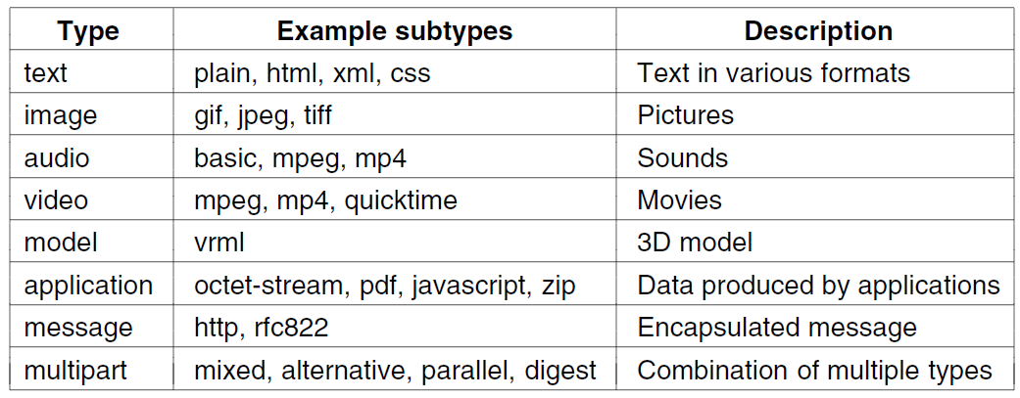
Message Formats (4)
MIME content types and example subtypes.

Slide 17
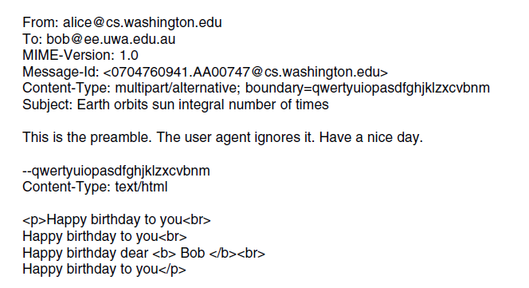
Message Transfer (1)
. . .
A multipart message containing HTML and audio alternatives.

Slide 18
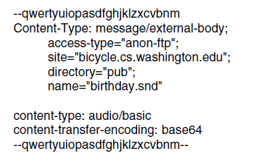
Message Transfer (2)
. . .
A multipart message containing HTML and audio alternatives.

Slide 19
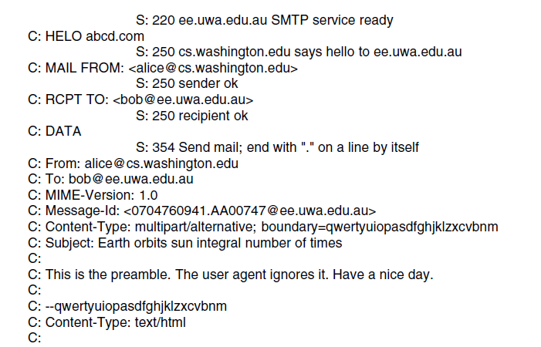
Message Transfer (3)
. . .
Sending a message from alice@cs.washington.edu to bob@ee.uwa.edu.au.

Slide 20
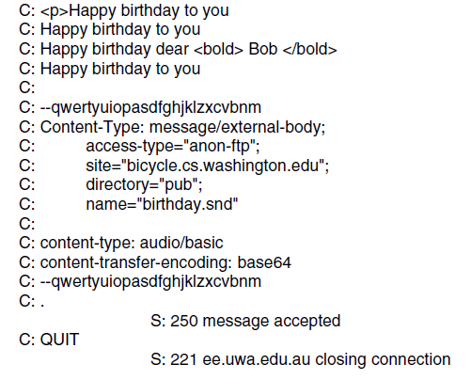
Message Transfer (4)
. . .
Sending a message from alice@cs.washington.edu to bob@ee.uwa.edu.au.

Slide 21
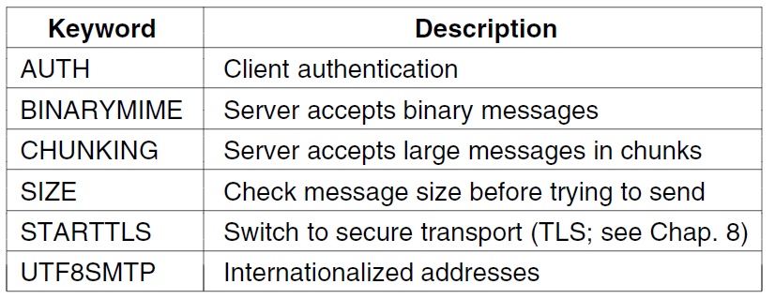
Message Transfer (5)
Some SMTP extensions.
The Internet Message Access Protocol Version 4rev2 (IMAP4rev2) allows a client to access and manipulate electronic mail messages on a server. IMAP4rev2 permits manipulation of mailboxes (remote message folders) in a way that is functionally equivalent to local folders. IMAP4rev2 also provides the capability for an offline client to resynchronize with the server.

Slide 22
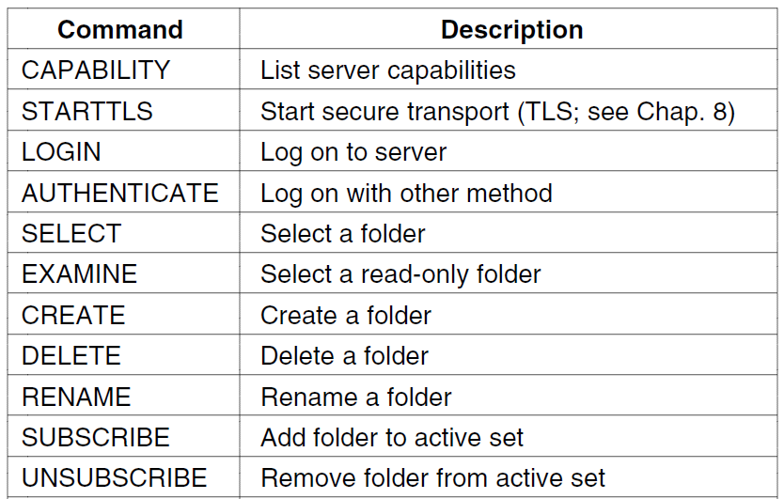
Final Delivery (1)
. . .
IMAP (version 4) commands.

Slide 23
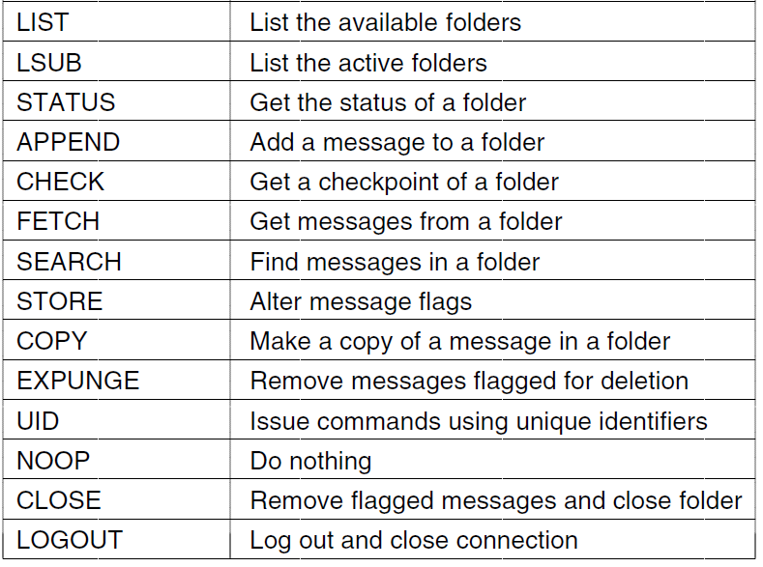
Final Delivery (2)
. . .
IMAP (version 4) commands.

Slide 24
The World Wide Web
Architectural overview
Static web pages
Dynamic web pages, web applications
The hypertext transfer protocol
The mobile web
Web search

Slide 25
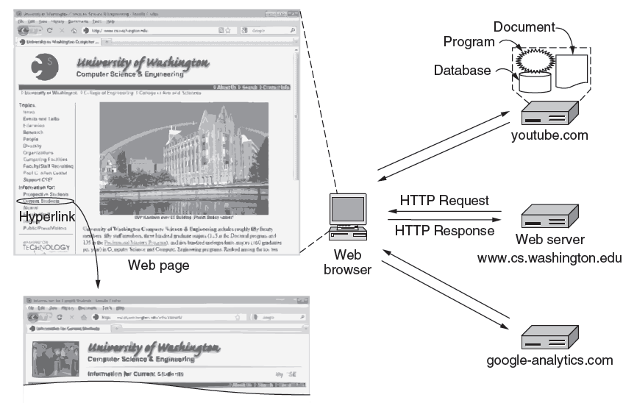
Architectural Overview (1)
Architecture of the Web.

Slide 26
Architectural Overview (2)
Three questions had to be answered before a selected page could be displayed:
What is the page called?
Where is the page located?
How can the page be accessed?

Slide 27
Architectural Overview (3)
Steps that occur when link is selected:
Browser determines the URL
Browser asks DNS for the IP address of the server
DNS replies
The browser makes a TCP connection
Sends HTTP request for the page
Server sends the page as HTTP response
Browser fetches other URLs as needed
The browser displays the page
The TCP connections are released

Slide 28
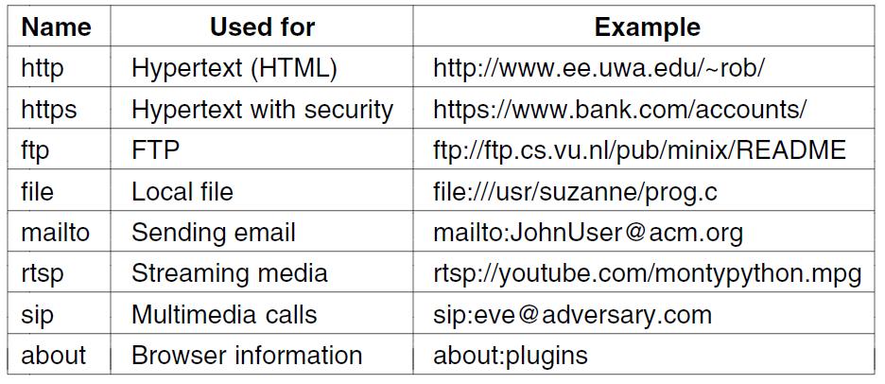
Architectural Overview (4)
Some common URL schemes.
The Session Initiation Protocol (SIP) is a signaling protocol used for initiating, maintaining, and terminating communication sessions that include voice, video and messaging applications. SIP is used in Internet telephony, in private IP telephone systems, as well as mobile phone calling over LTE (VoLTE-Voice over Long-Term Evolution).
Real Time Streaming Protocol (RTSP) is an application-level network communication system that transfers real-time data from multimedia to an endpoint device by communicating directly with the server streaming the data.

Slide 29
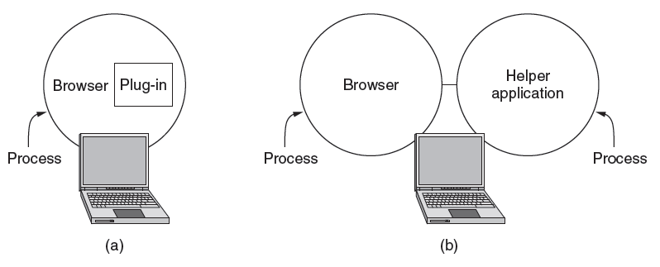
Architectural Overview (5)
(a) A browser plug-in. (b) A helper application.

Slide 30
Architectural Overview (6)
Steps server performs in main loop
Accept a TCP connection from client
Get path to page, name of file requested.
Get the file (from disk).
Send contents of the file to the client.
Release the TCP connection.

Slide 31
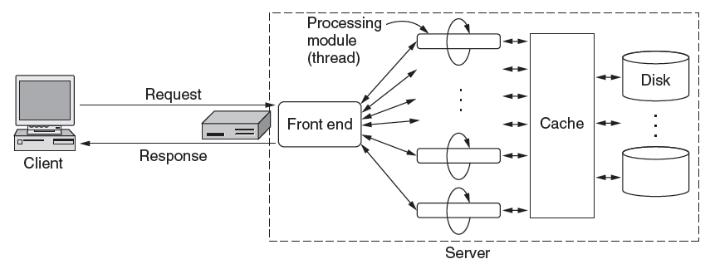
Architectural Overview
A multithreaded Web server with a front end and processing modules.

Slide 32
Architectural Overview
A processing module performs a series of steps:
Resolve name of Web page requested.
Perform access control on the Web page.
Check the cache.
Fetch requested page from disk or run program
Determine the rest of the response
Return the response to the client.
Make an entry in the server log.

Slide 33
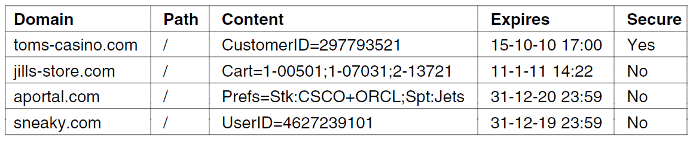
Architectural Overview
Some examples of cookies

Slide 34
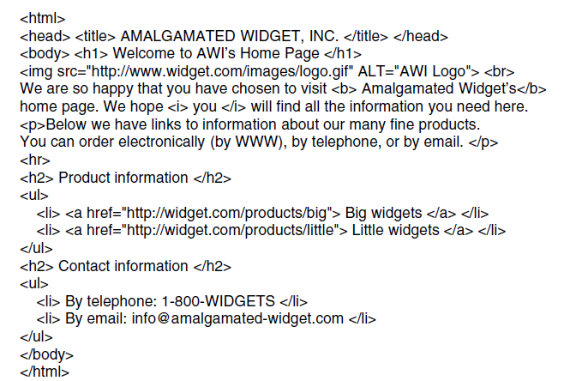
Static Web Pages (1)
The HTML for a sample Web page.

Slide 35
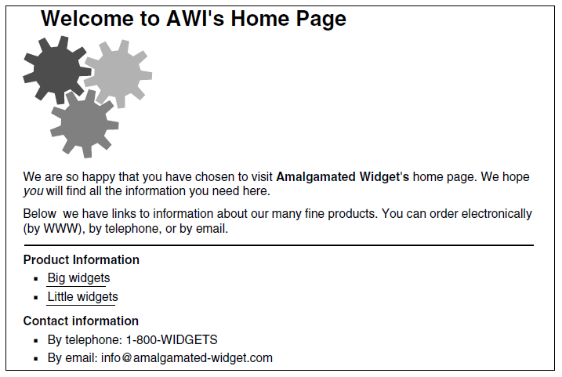
Static Web Pages (2)
The formatted page.

Slide 36
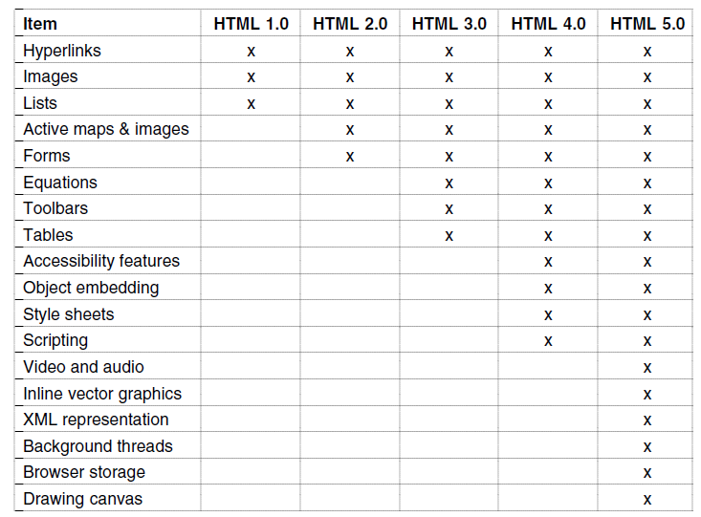
Static Web Pages (3)
Some differences between HTML versions.

Slide 37
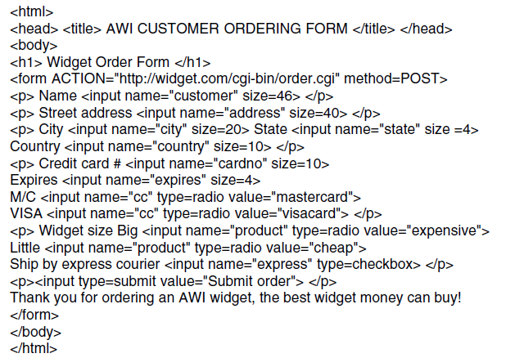
Static Web Pages (4)
The HTML for an order form.

Slide 38
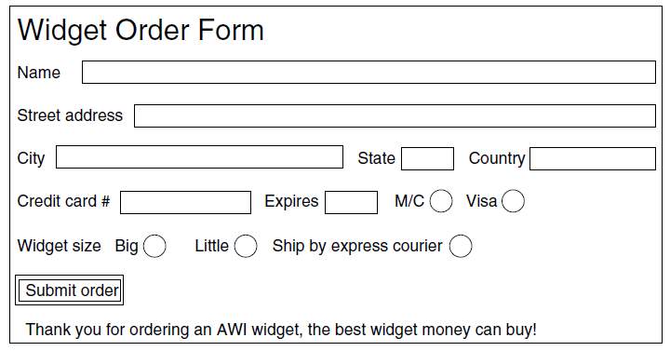
Static Web Pages (5)
The formatted page.

Slide 39
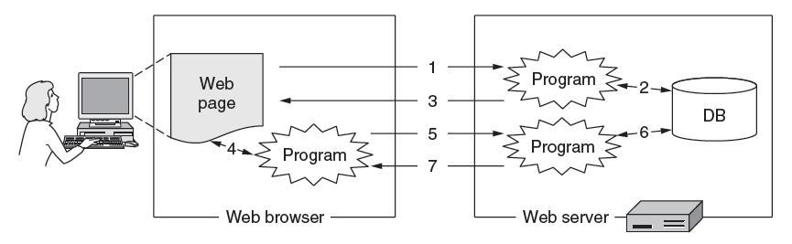
Dynamic Web Pages, Web Applications (1)
Dynamic pages

Slide 40
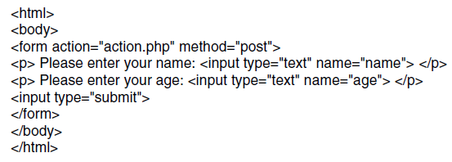
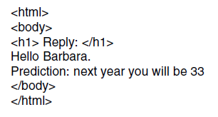
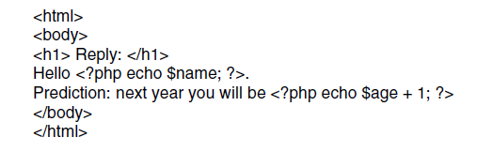
Dynamic Web Pages, Web Applications (2)
(a)
(c)
(b)
(a) A Web page containing a form.
(b) A PHP script for handling the output of the form.
(c) Output from the PHP script when the inputs are ‘‘Barbara’’ and ‘‘32’’, respectively.

Slide 41
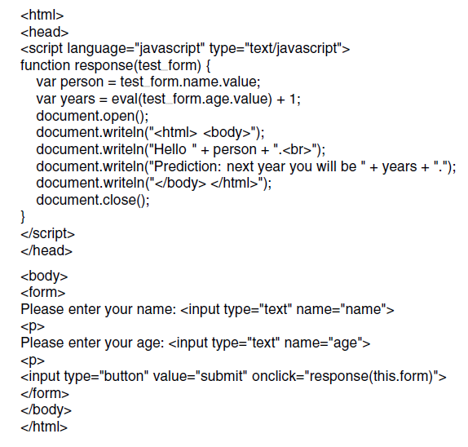
Dynamic Web Pages, Web Applications (3)
Use of JavaScript for processing a form.

Slide 42
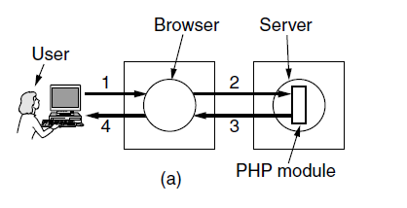
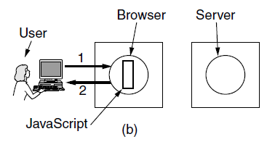
Dynamic Web Pages, Web Applications (4)
Server-side scripting with PHP.
Client-side scripting withJavaScript.

Slide 43
Dynamic Web Pages, Web Applications (5)
AJAX Technologies
Asynchronous JavaScript And XML. AJAX is not a programming language. AJAX just uses a combination of: A browser built-in XMLHttpRequest object (to request data from a web server) JavaScript and HTML DOM (to display or use the data)
HTML and CSS: present information as pages.
DOM: change parts of pages while they are viewed.
XML: let programs exchange data with the server.
An asynchronous way to send and retrieve XML data.
JavaScript as a language to bind all this together.

Slide 44
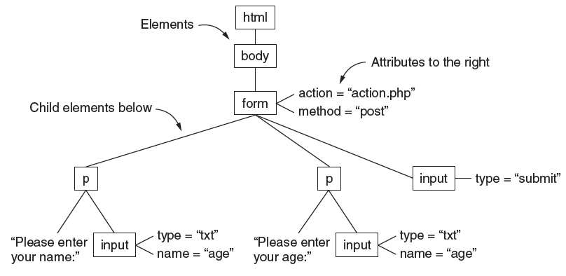
Dynamic Web Pages, Web Applications (6)
The DOM tree for the HTML in Fig. 7-30(a).

Slide 45
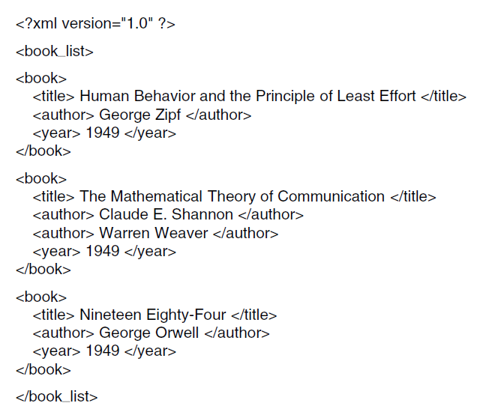
Dynamic Web Pages, Web Applications (7)
A simple XML document.

Slide 46
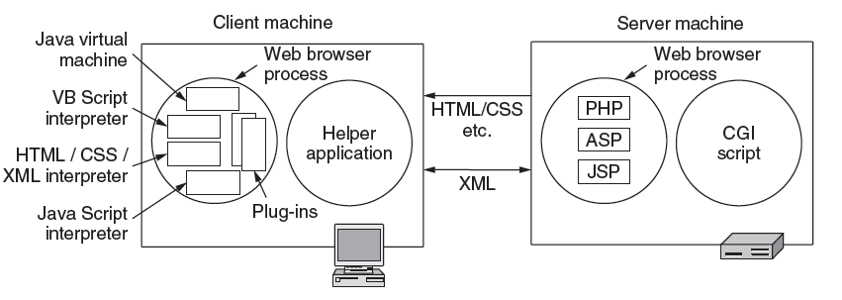
Dynamic Web Pages, Web Applications (8)
Various technologies used to generate dynamic pages.

Slide 47
Client Machine Scripting Languages
VBScript ("Microsoft Visual Basic Scripting Edition") is an Active Scripting language developed by Microsoft that is modeled on Visual Basic. It allows Microsoft Windows system administrators to generate powerful tools for managing computers with error handling, subroutines, and other advanced programming constructs.
JS-Interpreter is a sandboxed JavaScript interpreter written in JavaScript. It allows for execution of arbitrary JavaScript code line by line. Execution is completely isolated from the main JavaScript environment.
XML (Extensible Markup Language) is a markup language similar to HTML, but without predefined tags to use. Instead, you define your own tags designed specifically for your needs. This is a powerful way to store data in a format that can be stored, searched, and shared.
XML was designed to carry data - with focus on what data is
HTML was designed to display data - with focus on how data looks
XML tags are not predefined like HTML tags are

Slide 48
Server Machine Scripting Languages
CGI stands for Common Gateway Interface and provides an interface between the HTTP server and programs generating web content. These programs are better known as CGI scripts. They are written in a scripting language.
PHP: Hypertext Preprocessor: PHP is a widely-used, open source scripting language. PHP scripts are executed on the server. PHP is free to download and use.
ASP is Active Server Pages: ASP is a server side Web building scripting engine. It is generally a server page which includes embedded programming. On the Windows server, the programs are being processed.
JSP is Java Server Pages is a collection of technologies that helps software developers create dynamically generated web pages based on HTML, XML, SOAP, or other document types.
SOAP (Simple Object Access Protocol) is a message protocol that enables the distributed elements of an application to communicate. SOAP can be carried over a variety of standard protocols, including the web-related Hypertext Transfer Protocol (HTTP).

Slide 49
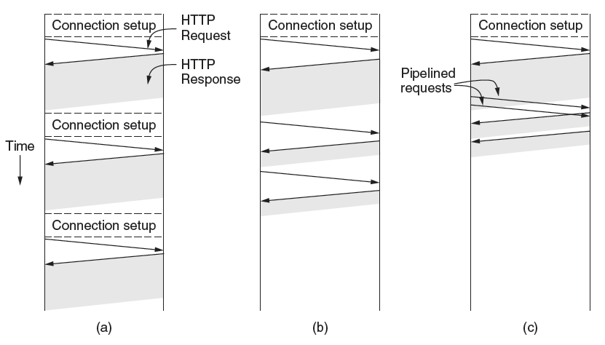
The HyperText Transfer Protocol (1)
HTTP with (a) multiple connections and sequential requests.
(b) A persistent connection and sequential requests.
(c) A persistent connection and pipelined requests.

Slide 50
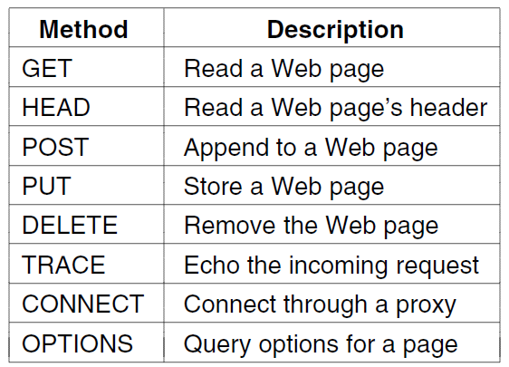
The HyperText Transfer Protocol (2)
The built-in HTTP request methods.

Slide 51
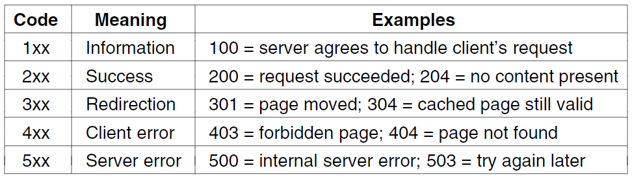
The HyperText Transfer Protocol (3)
The status code response groups

Slide 52
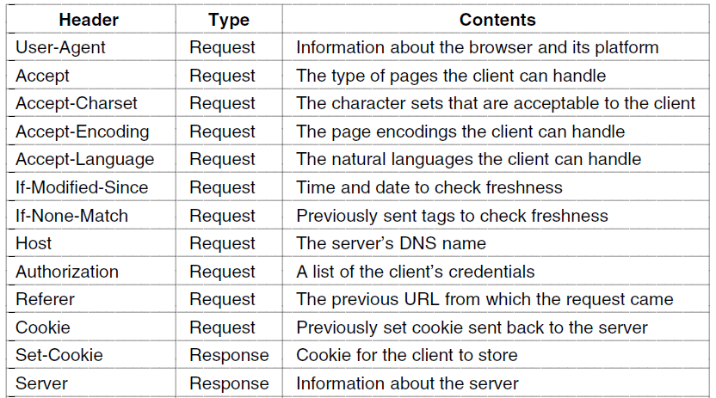
The HyperText Transfer Protocol (4)
. . .
Some HTTP message headers.

Slide 53
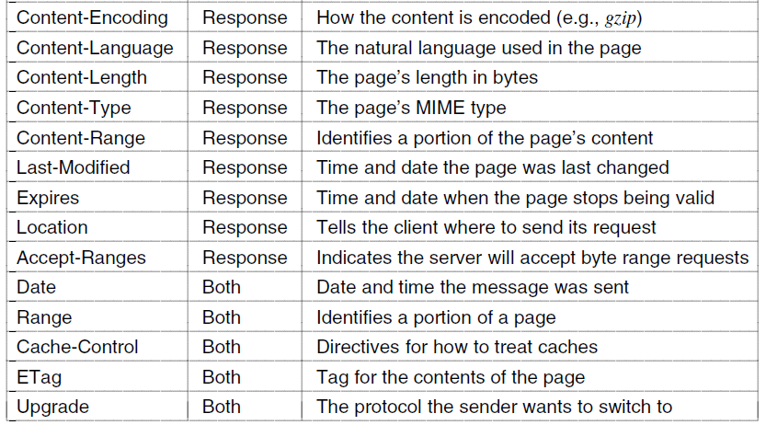
The HyperText Transfer Protocol (5)
. . .
Some HTTP message headers.

Slide 54
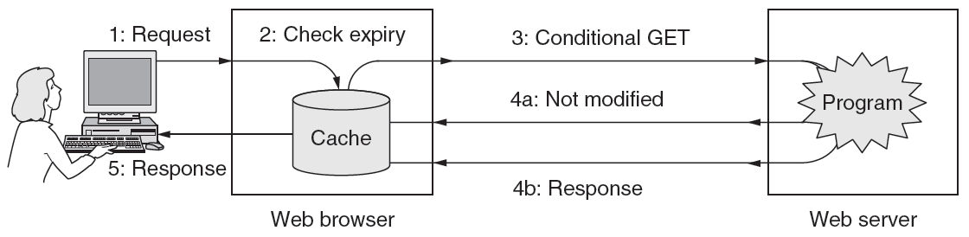
The HyperText Transfer Protocol (6)
HTTP caching.

Slide 55
Network Security

Slide 56
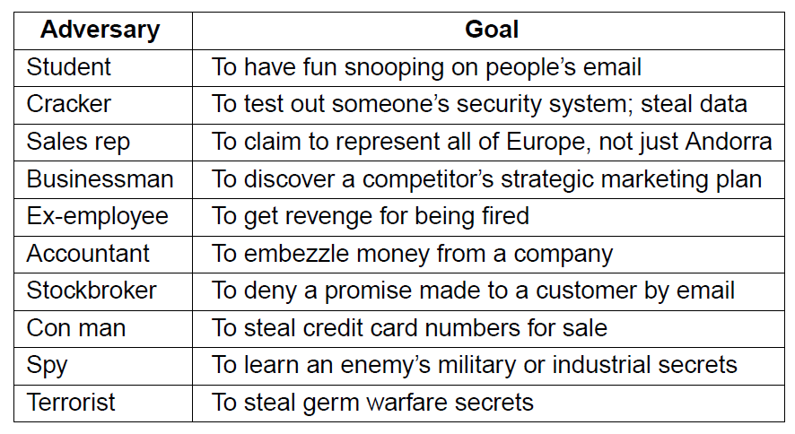
Network Security
Some people who cause security problems and why.

Slide 57
All these issues (secrecy, authentication, nonrepudiation, and integrity control) occur in traditional systems, too, but with some significant differences.
Integrity and secrecy are achieved by using registered mail and locking documents up.
In the network layer, firewalls can be installed to keep good packets and bad packets out. IP security also functions in this layer.
In the transport layer, entire connections can be encrypted, end to end, that is, process to process. For maximum security, end-to-end security is required.
Finally, issues such as user authentication and nonrepudiation can only be handled in the application layer.

Slide 58
Cryptography
Introduction
Substitution ciphers
Transposition ciphers

Slide 59
Cryptography comes from the Greek words for ''secret writing.'‘
A cipher is a character-for character or bit-for-bit transformation, without regard to the linguistic structure of the message.
In contrast, a code replaces one word with another word or symbol. Codes are not used any more, although they have a glorious history.
The messages to be encrypted, known as the plaintext, are transformed by a function that is parameterized by a key.
The output of the encryption process, known as the ciphertext, is then transmitted, often by messenger or radio.
We assume that the enemy, or intruder, hears and accurately copies down the complete ciphertext.

Slide 60
Sometimes the intruder can not only listen to the communication channel (passive intruder) but can also record messages and play them back later, inject his own messages, or modify legitimate messages before they get to the receiver (active intruder).
The art of breaking ciphers, called cryptanalysis, and the art devising them (cryptography) is collectively known as cryptology.
Ciphertext C = EK(P) to mean that the encryption of the plaintext P using key K gives the ciphertext C.
Similarly, P = DK(C) represents the decryption of C to get the plaintext again.
DK(Ek(P))=P
The idea that the cryptanalyst knows the algorithms and that the secrecy lies exclusively in the keys is called Kerckhoff's principle, named after the Flemish military cryptographer Auguste Kerckhoff who first stated it in 1883 (Kerckhoff, 1883).
Kerckhoff's principle: All algorithms must be public; only the keys are secret

Slide 61
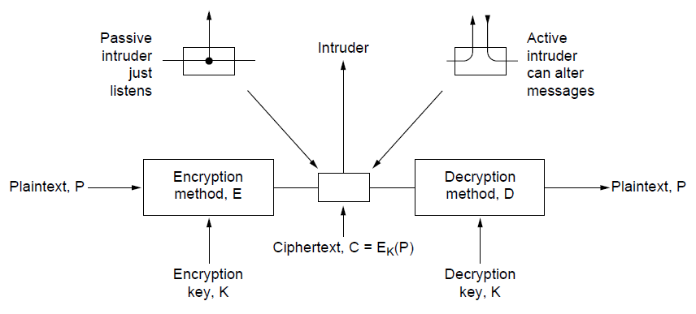
Introduction
The encryption model (for a symmetric-key cipher).

Slide 62
In a substitution cipher each letter or group of letters is replaced by another letter or group of letters to disguise it. One of the oldest known ciphers is the Caesar cipher, attributed to Julius Caesar. In this method, a becomes D, b becomes E, c becomes F, ... , and z becomes C. For example, attack becomes DWWDFN. In examples, plaintext will be given in lower case letters, and ciphertext in upper case letters.
Encryption methods have historically been divided into two categories:
Substitution ciphers and
Transposition ciphers.

Slide 63
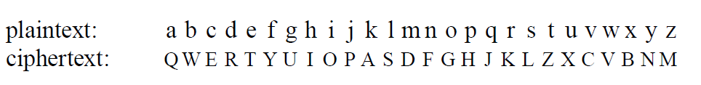
The general system of symbol-for-symbol substitution is called a monoalphabetic substitution, with the key being the 26-letter string corresponding to the full alphabet.
For the key above, the plaintext attack would be transformed into the ciphertext QZZQEA.
At first glance this might appear to be a safe system because although the cryptanalyst knows the general system (letter-for-letter substitution), he does not know which of the 26! ~ 4 x 1026 possible keys is in use. In contrast with the Caesar cipher, trying all of them is not a promising approach. Even at 1 nsec per solution, a computer would take 1010 years to try all the keys.
Monoalphabetic substitution

Slide 64
Substitution ciphers preserve the order of the plaintext symbols but mask them.
Transposition ciphers, in contrast, reorder the letters but do not mask them.
The below figure depicts a common transposition cipher, the columnar transposition.
The cipher is keyed by a word or phrase not containing any repeated letters. In this example, MEGABUCK is the key.
The plaintext is written horizontally, in rows, padded to fill the matrix if need be.
The ciphertext is read out by columns, starting with the column whose key letter is the lowest.
The number of columns, k, is small, each of the k(k - 1) column pairs can be examined to see if its diagram frequencies match those for English plaintext.

Slide 65
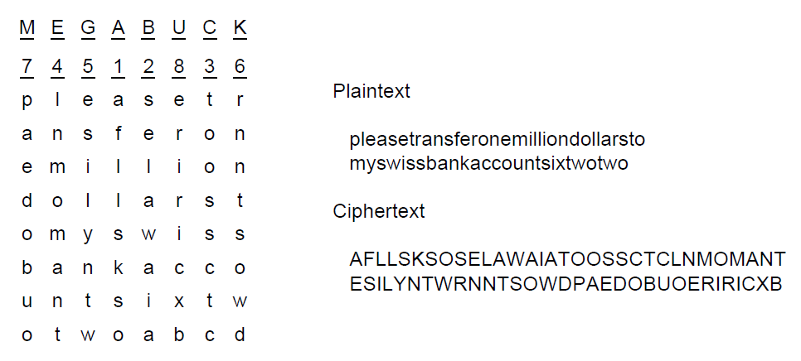
Transposition Ciphers
A transposition cipher
Some transposition ciphers accept a fixed-length block of input and produce a fixed-length block of output.

Slide 66

One-Time Pads (1)
The use of a one-time pad for encryption and the possibility of getting any possible plaintext from the ciphertext by the use of some other pad.

Slide 67

One-Time Pads (2)
An example of quantum cryptography

